Slide 1



Head of Sustainability Unit
Interreg Euro-MED GREENSMARTMED
Transnational Event
Building a Circular Textile Future through
Regional & Transnational Collaboration on EPR and DPP
6 November 2025
Sirma Zheleva
Head of Sustainability Unit
TexCycle

Slide 2
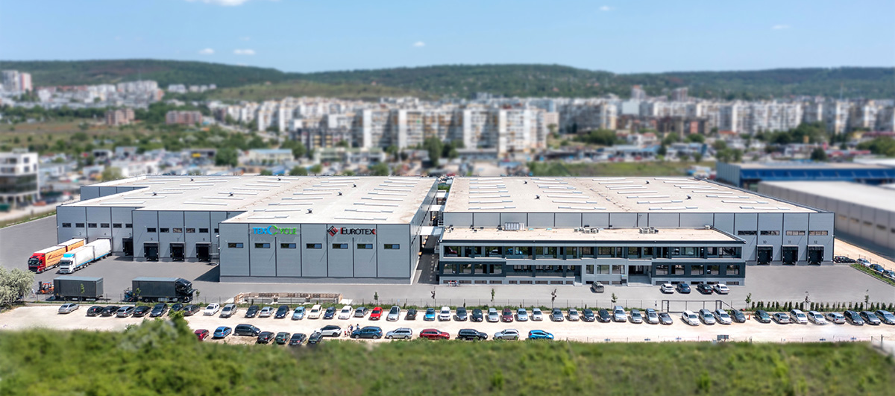

ABOUT US
Founded in 2000 in Varna, Bulgaria the company started initially with second-hand clothing sorting and wholesale.
25 YEARS OF EXPERIENCE
in the utilization of
unwanted textiles
450 EMPLOYEES
in 4 countries
5 CONTINENTS
serving customers
30 000+ SQ.M.
sorting and storage facilities

Slide 3
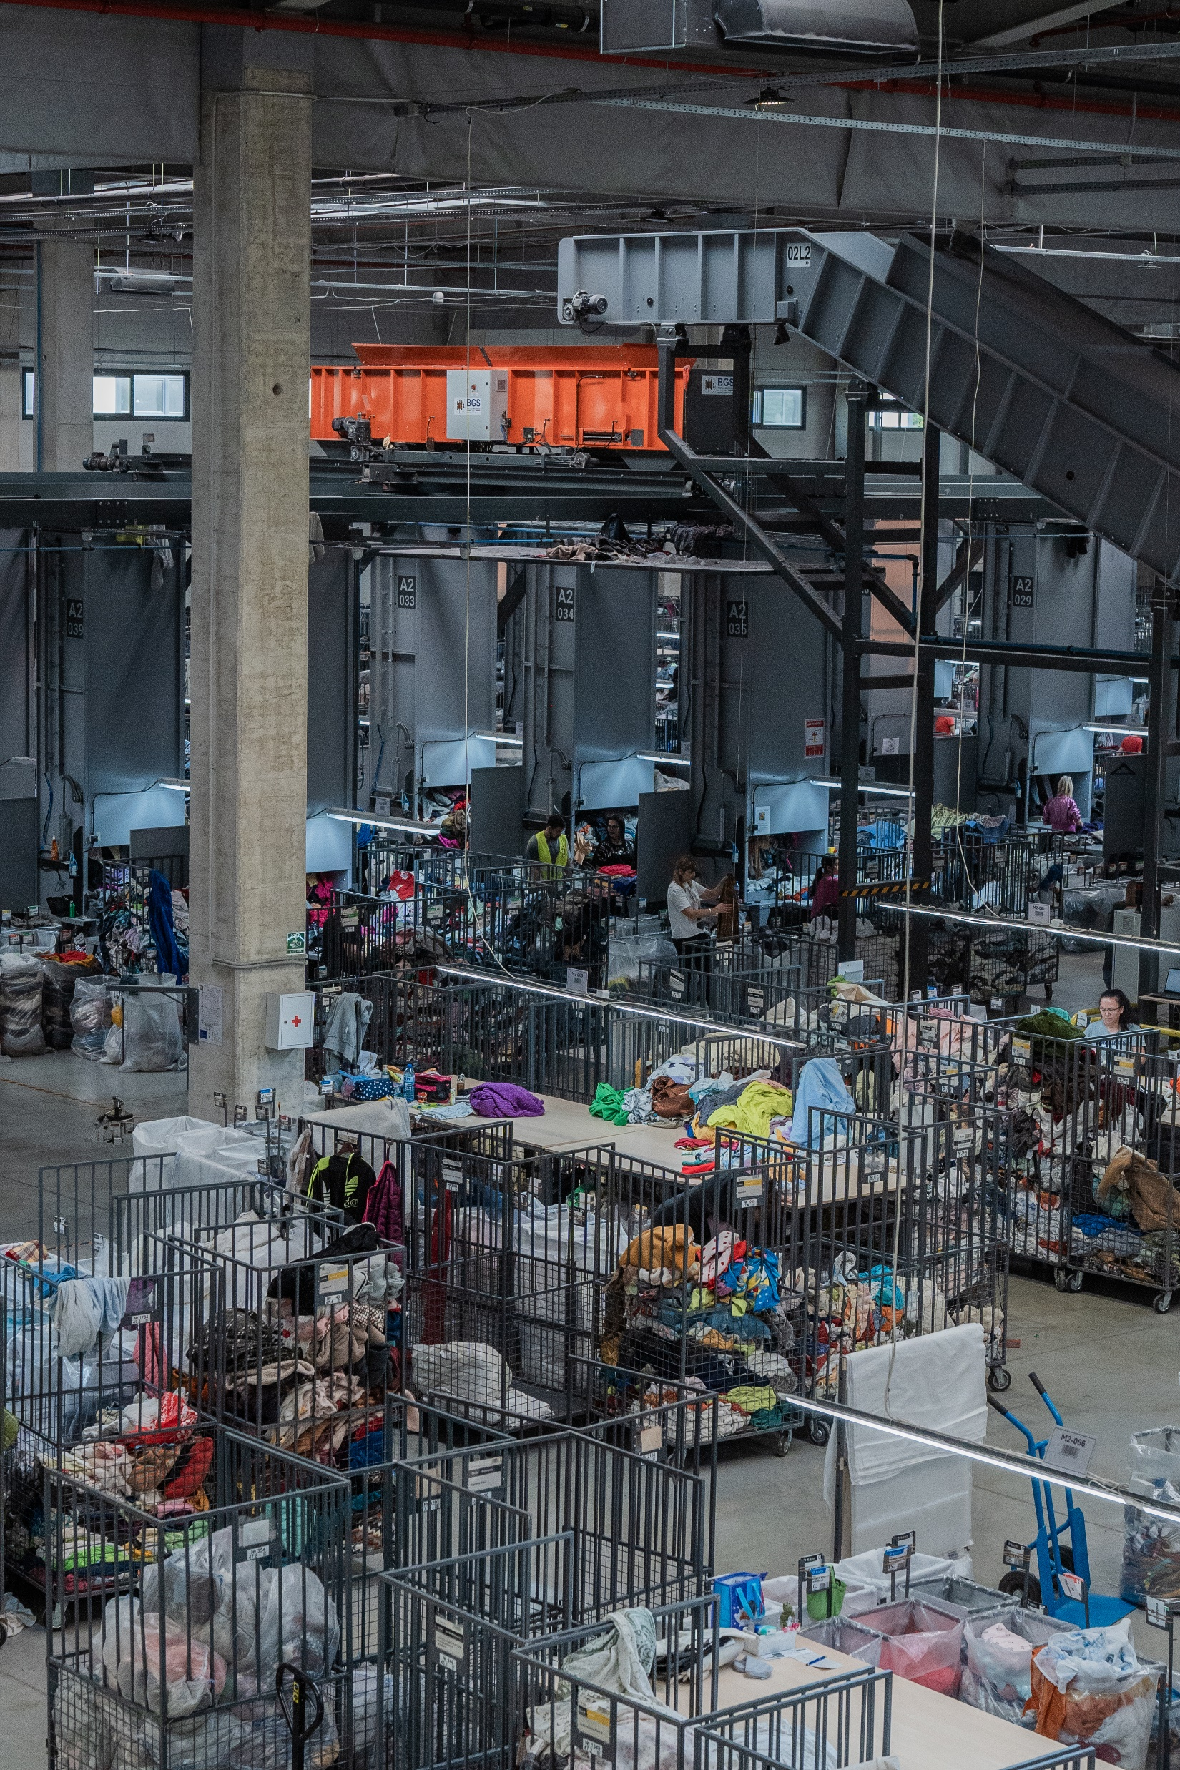
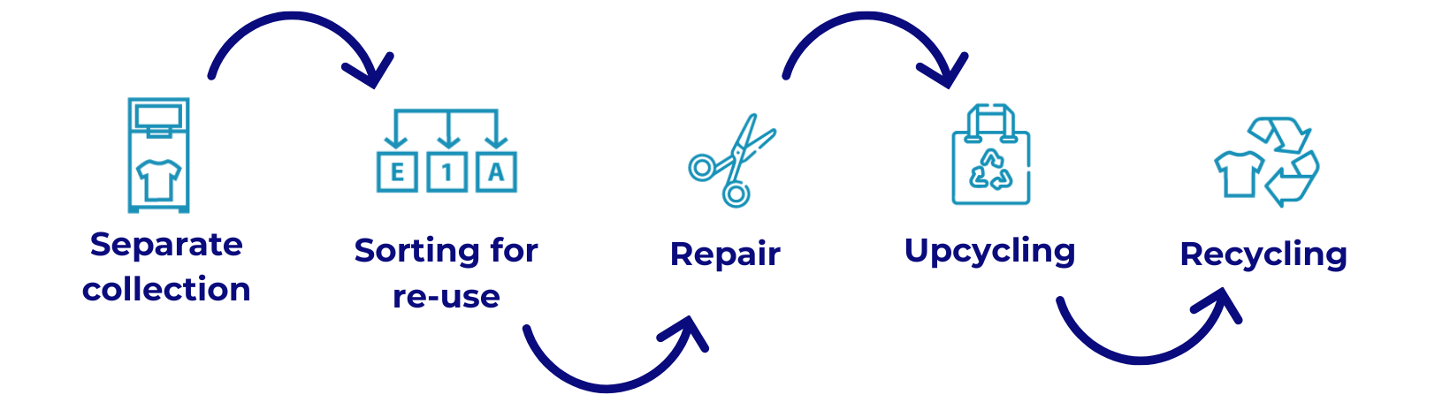
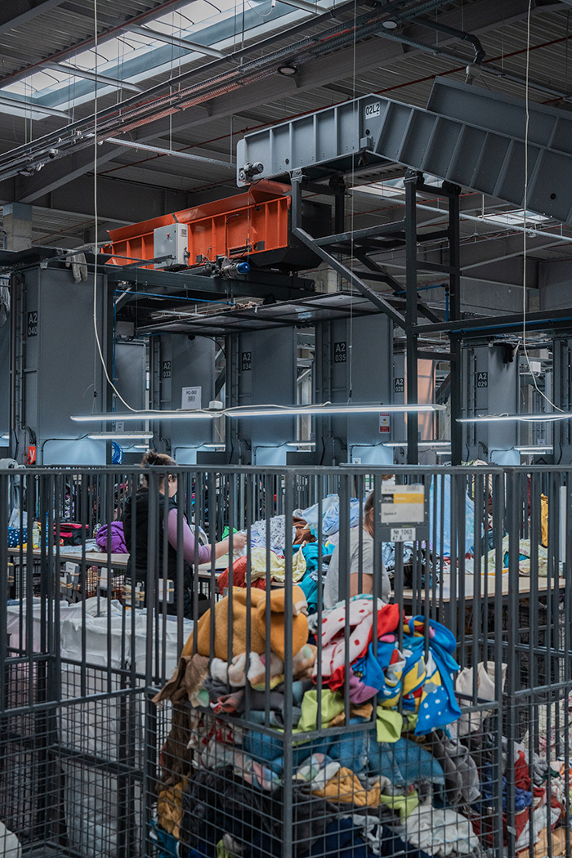
ABOUT US
Today, TexCycle has grown its activities towards developing sustainable and circular solutions for a closed-loop textile ecosystem.

Slide 4









PART OF THE GLOBAL RECYCLING COMMUNITY
We actively engage in the leading local, European and international textile recycling associations and projects and are committed to finding effective circular solutions in collaboration with the broader fashion and textile circularity industries.

Slide 5
Interreg Euro-MED GREENSMARTMED
Transnational Event
Building a Circular Textile Future through
Regional & Transnational Collaboration on EPR and DPP
6 November 2025
THANK YOU FOR YOUR ATTENTION!
Sirma Zheleva
Head of Sustainability Unit
TexCycle

