Slide 1



Interreg Euro-MED GREENSMARTMED
Transnational Event
Building a Circular Textile Future through
Regional & Transnational Collaboration on EPR and DPP
6 November 2025
Natasha Sivevska
Executive director
Macedonian TTTA-Textile cluster

Slide 2

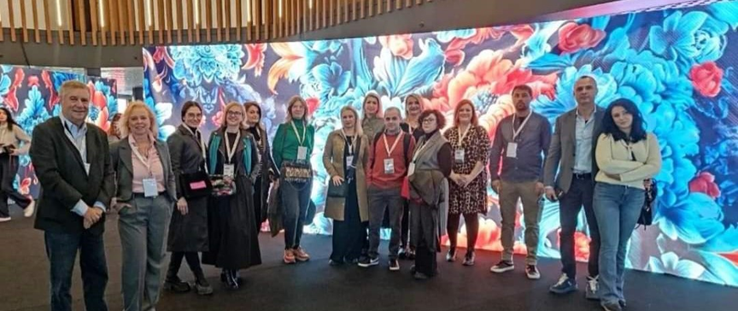
Main Activities
TTA-TC
Export promotion
Trade Fair participation, B2B events, Buyers’ missions, connecting with foreign clients and organizing their visit to production facilities, market research, capacity building for fair participation
Human resource development
Trainings and workshops, practical trainings in production reorganization, efficiency and time saving.
Certification
Support companies in the field of social compliance implementation (BSCI, SEDEX/SMETA, ESG, SA8000)
Circular Textile Production
Developing solutions, business cases and implementation. Projects to promote circular economy practices.
Lobby and advocacy - Government support programs, polices and laws.
TEXTILE TRADE ASSOCIATION - TEXTILE CLUSTER
Established in 2003 as a non-profit organization 85 member companies, accessories and sawing machines representatives, educational institutions - Universities, IT companies, PROs and foreign companies.

Slide 3

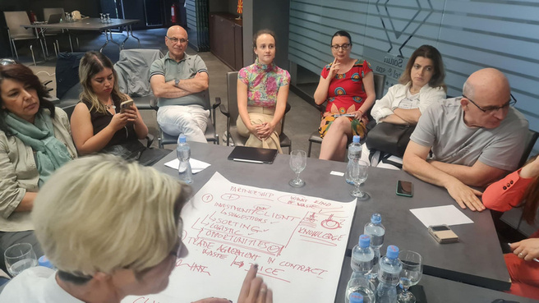

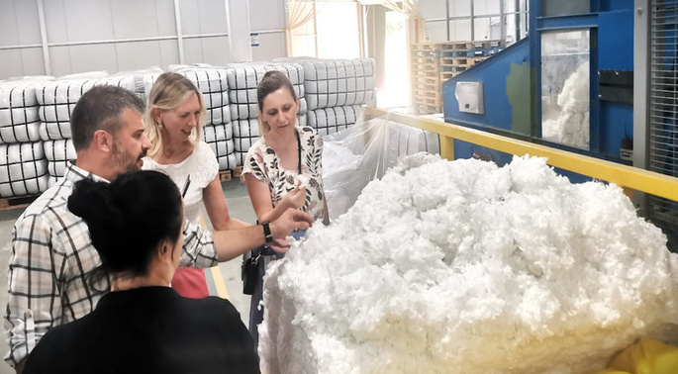

COMMITTED TO CIRCULARITY
Implementation projects to promote circular textile production
Active engagement with Ministry of the Environment and Spatial Planning and Custom authorities
Working on alternative recycling solutions
Projects: Deaign4Circle, TexRec, VERDEinMED on circular economy, Project MISSION4WATER on waste waters, SIPPO Project on Solutions for Textile Waste, OECD Roadmap Towards Circular Economy of RNM.
The Ministry monitors implementation of the activities and practices of waste management, including EPR activities, PROs and recyclers. The customs regulates textile waste reporting from import of textile products and from the CMT production.
Facilitated the initial coordination of resources, expertise, and stakeholders to efficiently identify and implement innovative strategies for recycling textiles.

Slide 4



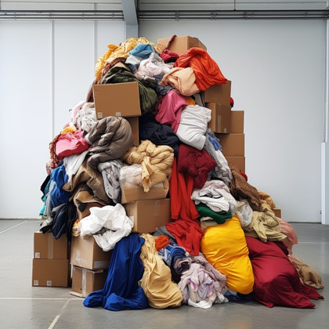
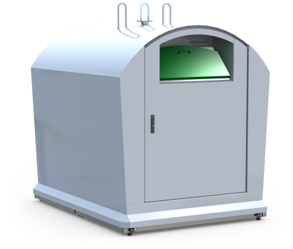
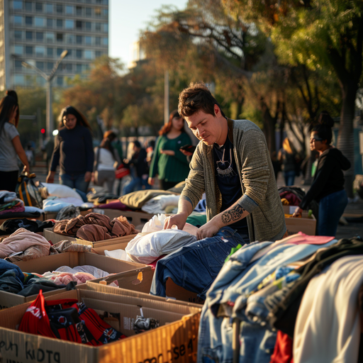
EPR ACTIVITIES IN NORTH MACEDONIA
The EPR act regulates the type of responsibility of producers after the end of the consumption phase of the products they put on the market in the Republic of North Macedonia and it is in force from 01.01.2024
1
3
Subsidizes licensed companies - PROs that perform selection, collection and transportation of textile waste. With this, the textile waste will be ready for reuse, recycling, creation of innovative products.
Organizes educational campaigns in schools with the aim of inculcating a cultural and environmental mentality among children from an early age.
2
4
Organizes media campaigns to motivate and inform citizens how important the correct selection of textiles and textile waste is and to raise awareness that it is a valuable resource.
Invests in infrastructure - installation of appropriate containers for the selection of textile waste and textile products.
Source: Teksomak. (n.d.). Home.

Slide 5
Interreg Euro-MED GREENSMARTMED
Transnational Event
Building a Circular Textile Future through
Regional & Transnational Collaboration on EPR and DPP
6 November 2025
THANK YOU FOR YOUR ATTENTION!
Natasha Sivevska
Executive director
www.tta.org.mk

