Slide 1

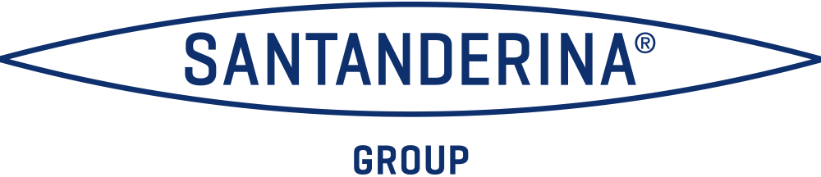


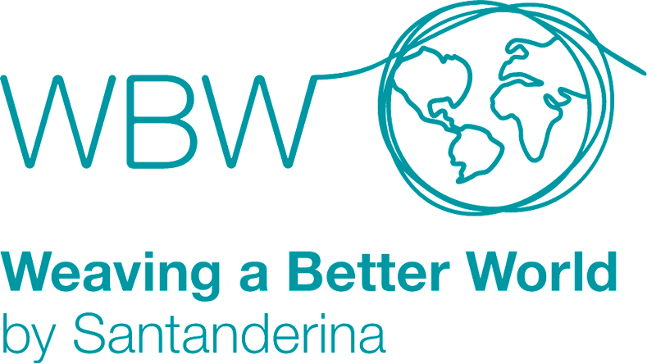

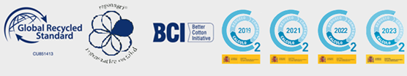

WORKWEAR
CORPORATEWEAR
INDUSTRIAL LAUNDRY
PROTECTIVEWEAR
MILITARYWEAR
FASHION FABRICS
DYED FABRICS
DENIM
FABRIC FOR GARMENT DYE
A leading European textile industry group with a complete, traceable, vertical production system.
Santanderina Group distributes flexibly all over the world and has been recognized for its textile specialization, professionalism and social and environmental commitment.
Design
Spinning
Weaving
Dyeing
Finishing
Printing
Making up
Recycling
5 million garments per year
30 million meters per year
10.000 tons of yarn per year

