Slide 1



Interreg Euro-MED GREENSMARTMED
Transnational Event
Building a Circular Textile Future through
Regional & Transnational Collaboration on EPR and DPP
6 November 2025
Fabiana Pirola
Project coordinator

Slide 2
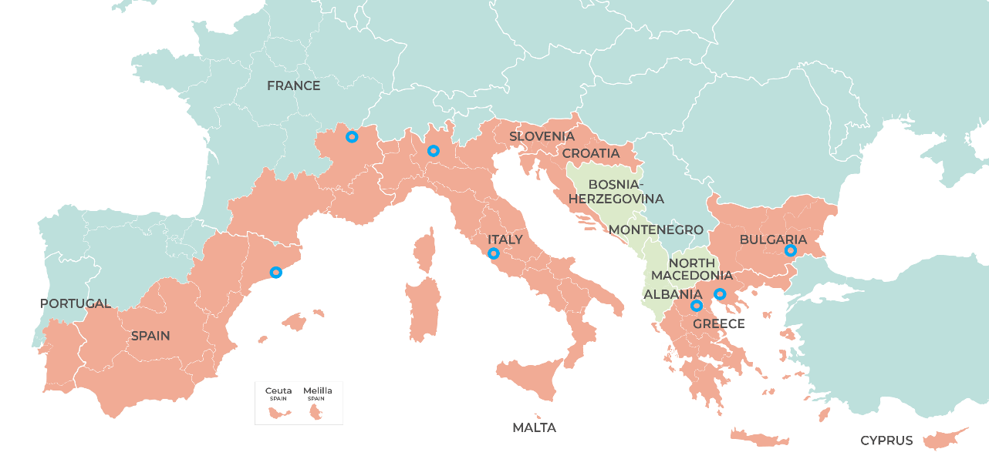


















Green and Resilient European Excellence Network for Smart MED SMEs
Associated partners:
Notes:
Organized within the framework of the Interreg Euro-MED GREENSMARTMED project by the Italian partners University of Bergamo – LP, CUEIM, and AFIL, with the support of CERTH and TEXFOR
Greece
Certh - The Centre for Research & Technology, Hellas
RDF - Regional Development Fund Of Western Macedonia
Bulgaria
SZREDA - Stara Zagora Regional Economic Development Agency
Italy:
CUEIM - Consorzio Universitario di Economia Industriale e Manageriale
AFIL Associazione fabbrica intelligente Lombardia
Spain
Eurecat Centre Tecnològic - Innovant per a les empreses
TEXFOR - Confederación de la Industria Textil
France
Polymeris Competitiveness Cluster for Rubbers, Plastics and Composites
Universite Claude Bernard Lyon 1

Slide 3





Green and Resilient European Excellence Network for Smart MED SMEs
Develop, test, and make transferable
the GREENSMARTMED methodology and toolkit, aiming at enhancing transregional cooperation among QHs stakeholders to create a European community bringing innovation in green manufacturing, contributing to the RIS3 implementation with a value chain perspective, and helping SMEs to turn sustainability challenges into business development opportunities.
Polymers
Textile
Machinery
Mobility & Battery
Agrifood
Notes:
Organized within the framework of the Interreg Euro-MED GREENSMARTMED project by the Italian partners University of Bergamo – LP, CUEIM, and AFIL, with the support of CERTH and TEXFOR

Slide 4
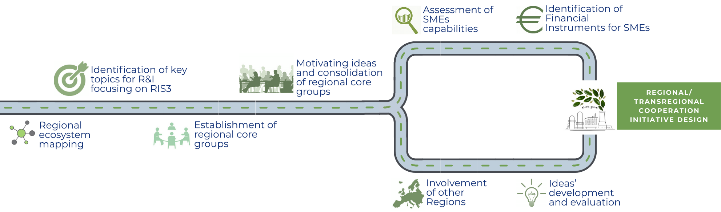
In three simple steps, our project enables:
Creation of Regional working groups focused on RIS3
Assessment and suggestions for SMEs
Identification of synergies at MED level
2
1
3

Slide 5
Agenda
Greetings from the Interreg Euro-MED Innovative and Sustainable Economy Mission – Maximizing The Impact of Sustainable Solutions: the ISE Mission & the GREENSMARTMED Project
Alessandro Daraio, Emilia-Romagna Region
Introduction to the Round Table Sessions - From Compliance to Innovation: How EPR and DPP enable green manufacturing
Valentina Oliviero, CUEIM
Roundtable
Extended Producer Responsibility
Making EPR Work Across Borders
Moderator: Valantis Ketikidis. CERTH
Roundtable
Digital Product Passport: Challenges & Opportunities for the Textile sector
Moderator: Carlo Mondani, AFIL
Fabio Tognocchi, ERP Italia Servizi
Andrea Minutolo, Legambiente Nazionale APS
Sirma Zheleva, TExCycle
Natasha Sivevska, Macedonian Textile Trade Association (TTA) – Textile Cluster
Claudio Daniele Brugnoni, Centrocot
Eva Alonso Núñez, Velamen
Javier Martinez Elices, Textil Santanderina
David Allo, TEXFOR
… Light lunch
Notes:
We have two roundtable on EPR and DPP that gather representative from both business support organizations, cluster and association and companies, all of them facing the challenges and the opportunies connected to these topics that will be briefly introduced

Slide 6
Interreg Euro-MED GREENSMARTMED
Transnational Event
Building a Circular Textile Future through
Regional & Transnational Collaboration on EPR and DPP
6 November 2025
Fabiana Pirola
Project coordinator

