Slide 1




Interreg Euro-MED GREENSMARTMED
Transnational Event
Building a Circular Textile Future through
Regional & Transnational Collaboration on EPR and DPP
6 November 2025
Claudio D. Brugnoni
Multilab Director – Area Manager Multisectoral R&I CENTROCOT S.p.A.
claudio.brugnoni@centrocot.it

Slide 2
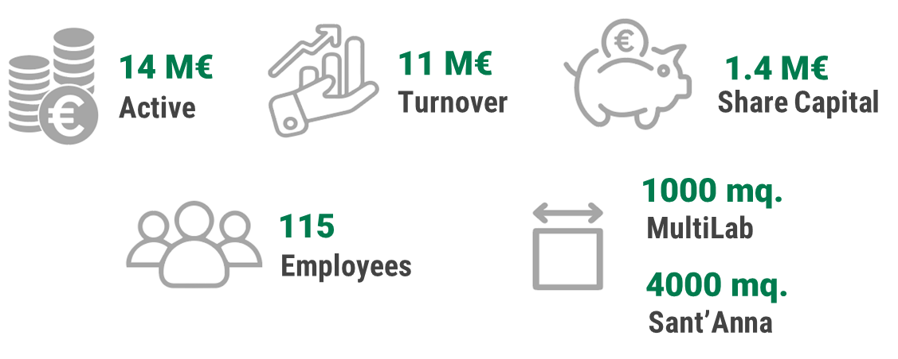

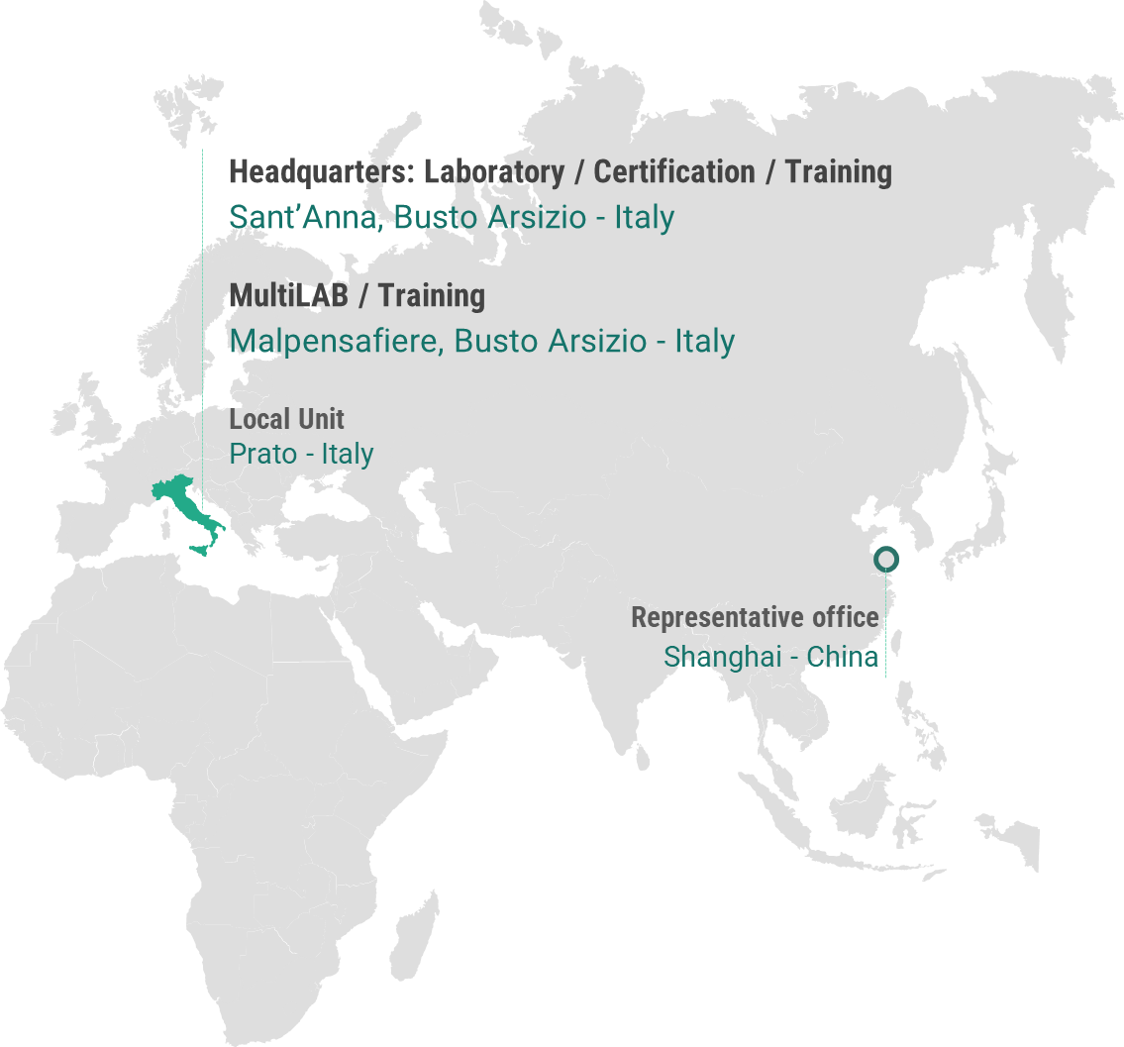
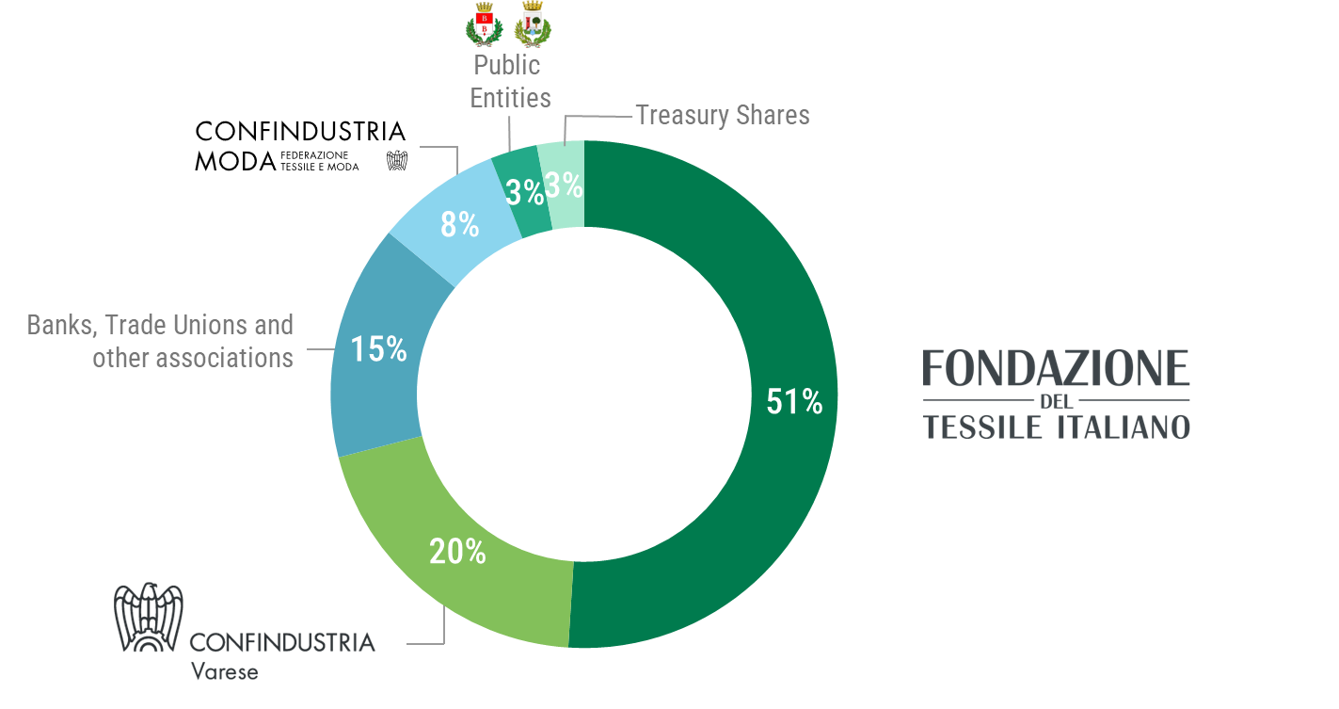
About us
Ref. 2024

Slide 3
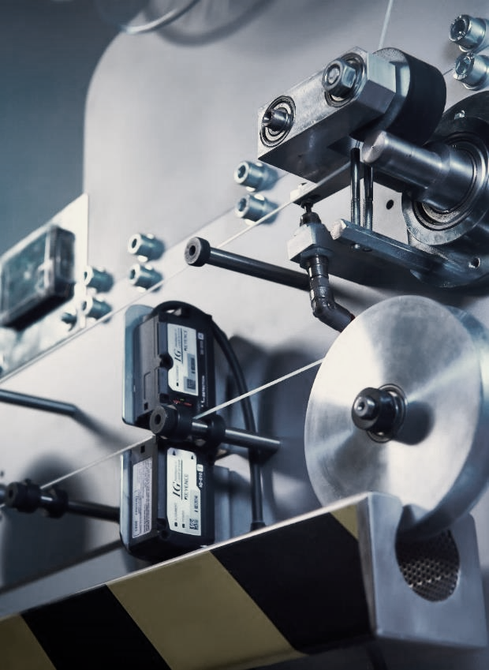
MultiLab
The multi-sectoral experimental laboratory to support companies that want to tackle the new fields of innovation related to sustainability and Circular Economy.
1000 sqm of laboratories
+120 Partners/Suppliers (of which research centers, universities and companies)

Slide 4
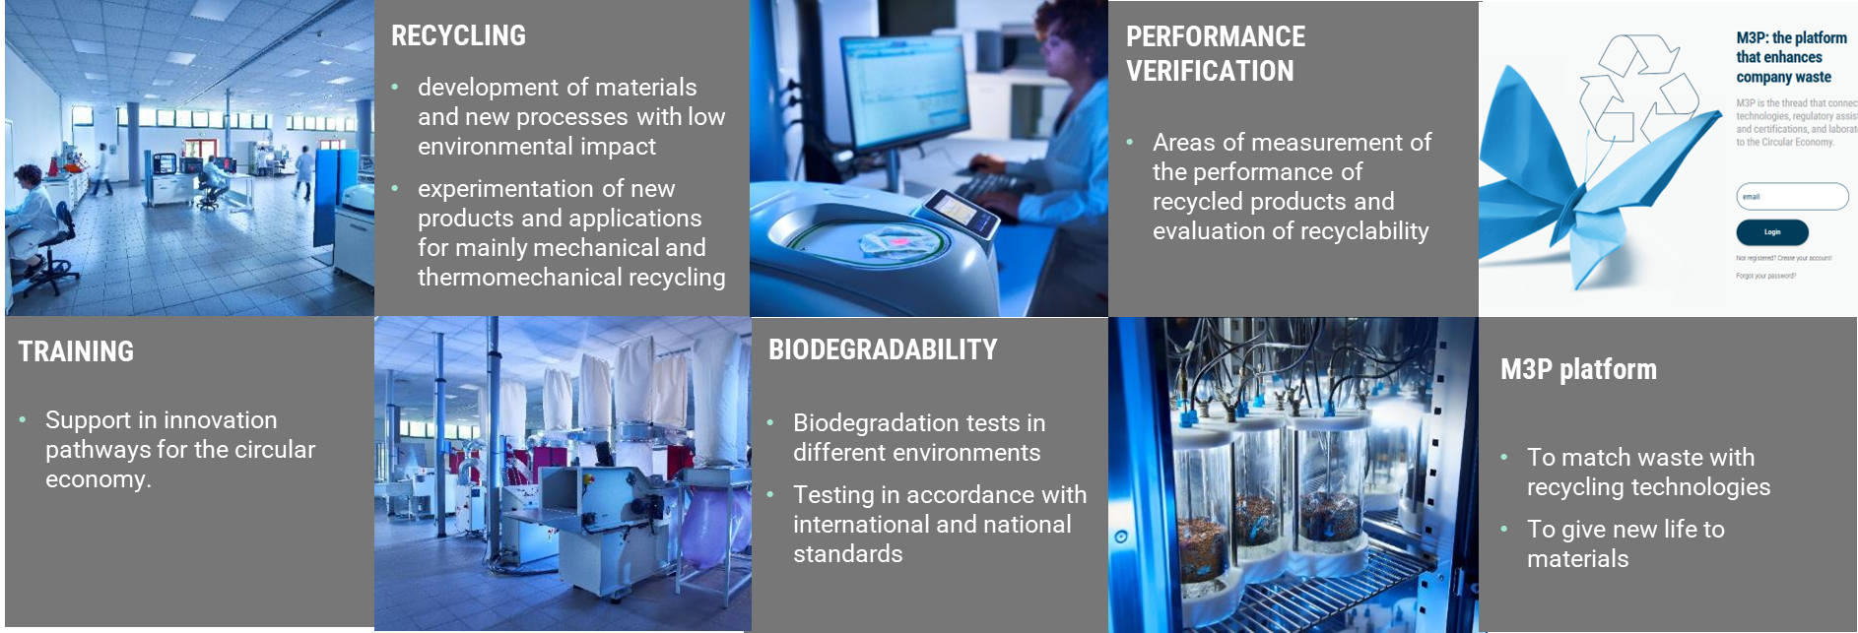
MultiLAB – An innovative approach

Slide 5
Interreg Euro-MED GREENSMARTMED
Transnational Event
Building a Circular Textile Future through
Regional & Transnational Collaboration on EPR and DPP
6 November 2025
THANK YOU FOR YOUR ATTENTION!
Claudio D. Brugnoni
Multilab Director – Area Manager Multisectoral R&I CENTROCOT S.p.A.
claudio.brugnoni@centrocot.it

